Slide 1

Satellite Terrain Image Classification
SC1015 GROUP PROJECT
HARBOR
1998
FDAA Team 2
Rachel Tan Min Zhi U2320358K
Saffron Salmah Yen Lim U2321216J
Sanjana Shanmugasundaram U2321261L
RIVER
1998
Notes:
Hello! I’m Saffron and with me are Rachel and Sanjana from FDAA Team 2. Today, we will be presenting our project on Satellite Terrain Image Classification.

Slide 2

TABLE OF CONTENTS
01.
02.
03.
04.
INTRODUCTION AND PROBLEM STATMENT
DATA PREPARATION AND CLEANING
EXPLORATORY DATA ANALYSIS
MACHINE LEARNING TECHNIQUES
05.
INSIGHTS AND RECOMMENDATIONS
Notes:
We will first introduce the topic we are tackling and our problem statement, before describing our dataset and how we processed it for model training. Next, we will explain the results of our exploratory data analysis and the various machine learning techniques we employed for our project task. Lastly, we will delve into some of our insights and future recommendations.

Slide 3

01.
INTRODUCTION AND PROBLEM STATEMENT
T
1
Notes:
Moving on to the introduction…

Slide 4

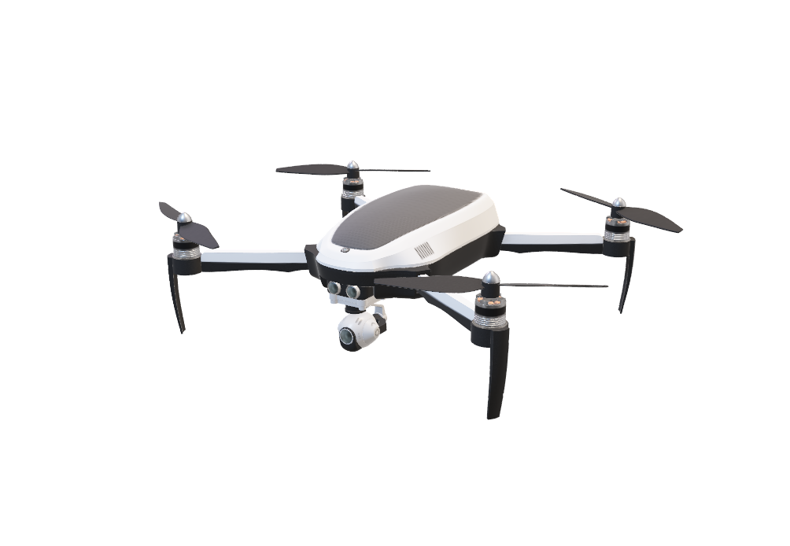
UNMANNED AERIAL VEHICALS (UAVs)
Capabilities
UAVs
Able to carry payloads, capture high-resolution live footage, and navigate rough terrain
Autonomously guided aircraft
Use Cases
Benefits
Used in a diverse array of situations: education, leisure, industry, military and security
Effective in high-risk, time-sensitive situations
(HHLH Sky GmbH, 2023; Mohsan et. al., 2023)
Notes:
Unmanned Aerial Vehicles (UAVs) are aircraft that are guided autonomously, by remote control, or a combination of both. UAVs have the capability to access isolated or dangerous areas, and can capture and transmit data through sensors, electronic receivers, and transmitters. They are able to capture high-resolution imagery or carry payloads like offensive ordnance. With their many capabilities, UAVs are used in diverse applications such as for commercial, leisure, military and security purposes. They are particularly effective in high-risk and time-sensitive scenarios.

Slide 5

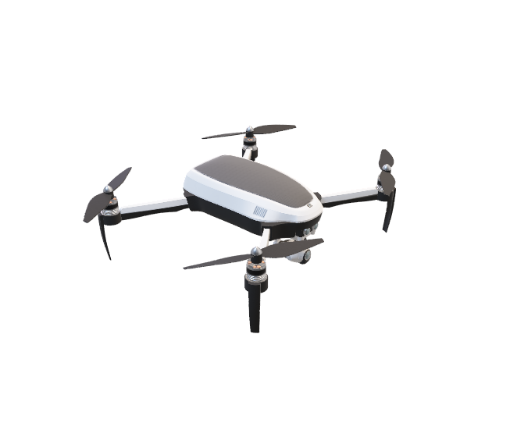
MILITARY USE OF UAVs
UAVs are becoming more commonplace in military arsenals
Utilised in strategic and operational reconnaissance and for battlefield surveillance and intervention
Increased digitalisation and automation in defence forces
Beneficial for UAVs to independently identify their surroundings
(Guilmartin & Taylor, 2024; Ng, 2022)
Notes:
As technology advances, so do the tools of war. UAVs are becoming commonplace in modern military arsenals. They are used for strategic and operational reconnaissance and for battlefield surveillance and intervention . With an increasing focus on digitalization and automation in defense forces, it would be crucial for UAVs to be able to identify and classify their surroundings without a human operator. Additionally, this improves safety, efficiency and requires fewer resources due to less human intervention being required.

Slide 6
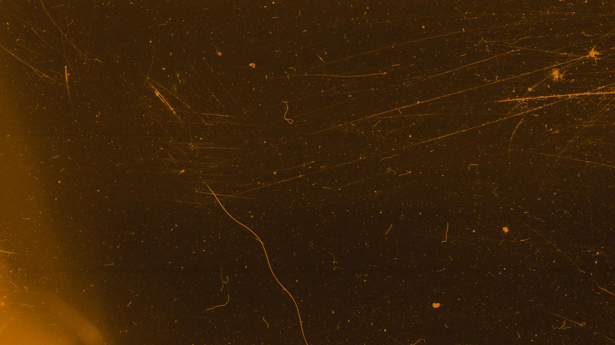
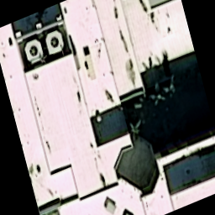
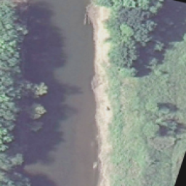
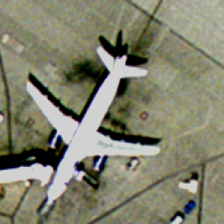
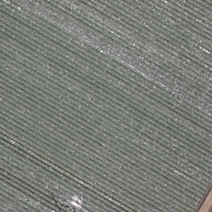
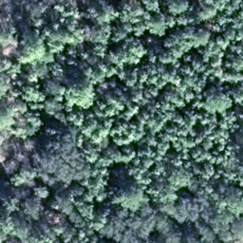
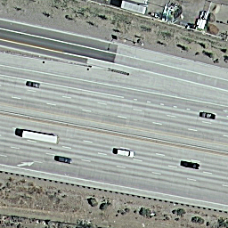
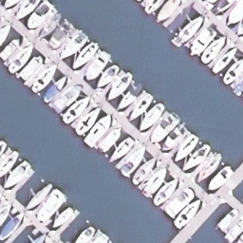
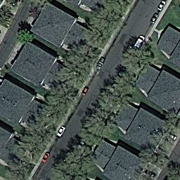
PROBLEM STATEMENT
Notes:
This leads us to our problem statement…

Slide 7
PROBLEM STATEMENT
How can we train an accurate terrain classification model using satellite imagery, for future use in UAVs?
Notes:
How can we train an accurate terrain classification model using satellite imagery, for future use in UAVs for defense purposes ? I’ll now pass the time on to Sanjana

Slide 8

DATA PREPARATION AND CLEANING
02.

Slide 9
DATASET CHARACTERISTICS
Dataset: UCMerced (University of California Merced) Land Use from Kaggle
21 classes with 500 images per class
2 classes were omitted due to irrelevance (agriculture and chaparral)
Image dimensions: 256 x 256
Sample size: 9501 images

Slide 10
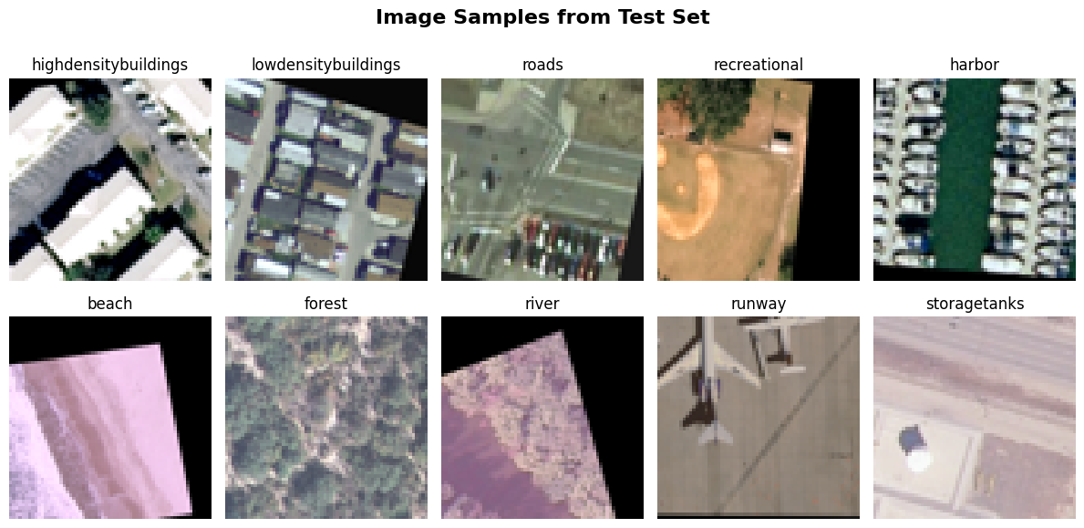
DATASET TRANSFORMATION
We merged the remaining 19 classes into 10 classes based on similarity
(e.g., buildings + denseresidential + mediumresidential = highdensitybuildings)

Slide 11
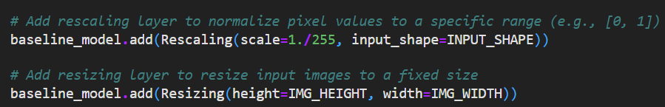
DATA PREPARATION
Data normalisation of pixel values
Increased accuracy
Faster training times
Reshaped images to 100 x 100 px
Increase model efficiency
Reduce memory requirements

Slide 12
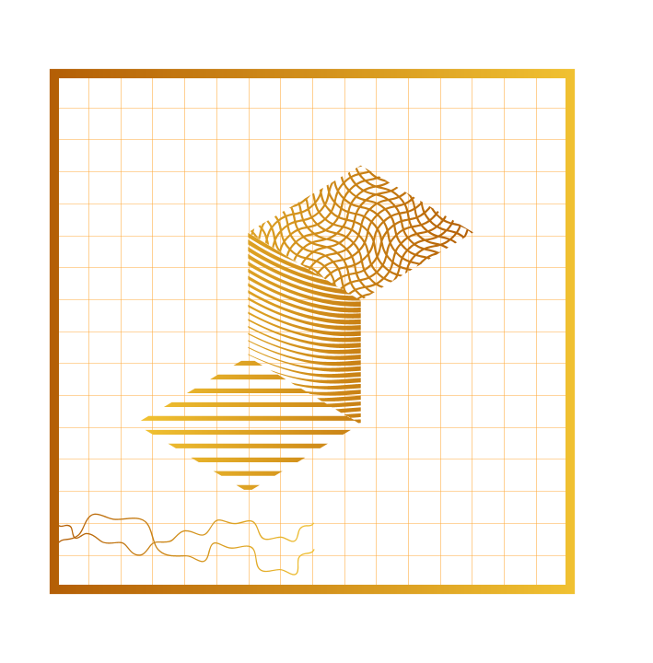
03.
EXPLORATORY DATA ANALYSIS

Slide 13
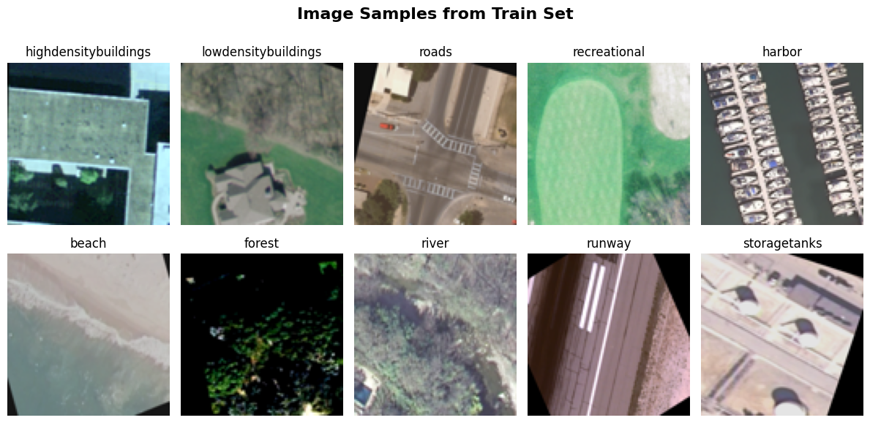
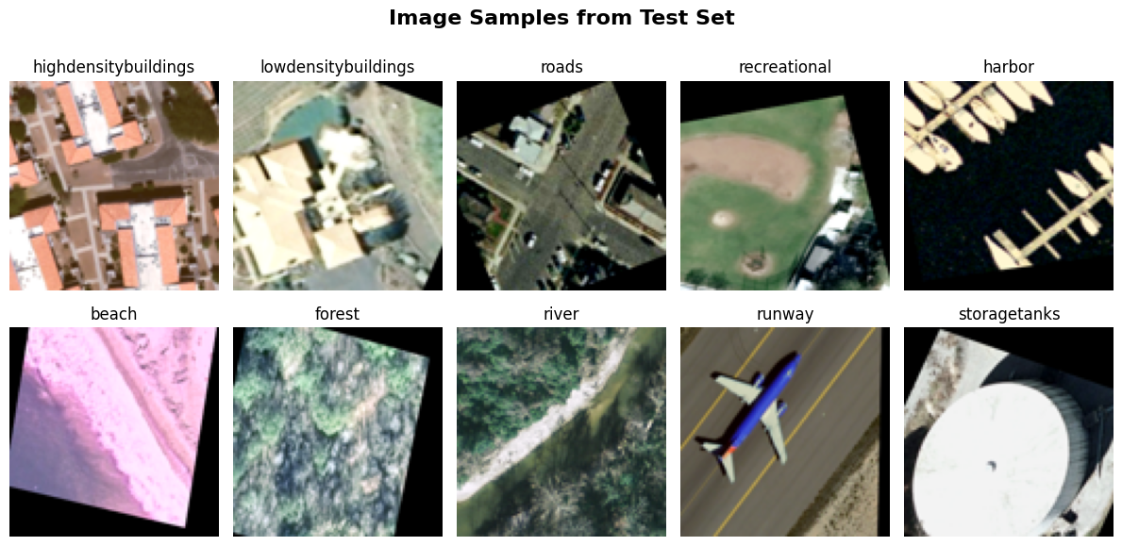
IMAGE SAMPLES
Image Quality
Poor Image Resolution
Low Colour Contrast
Mostly Muted Colours
Images were already augmented
Augmented with rotation
Increased samples from 100 to 500

Slide 14
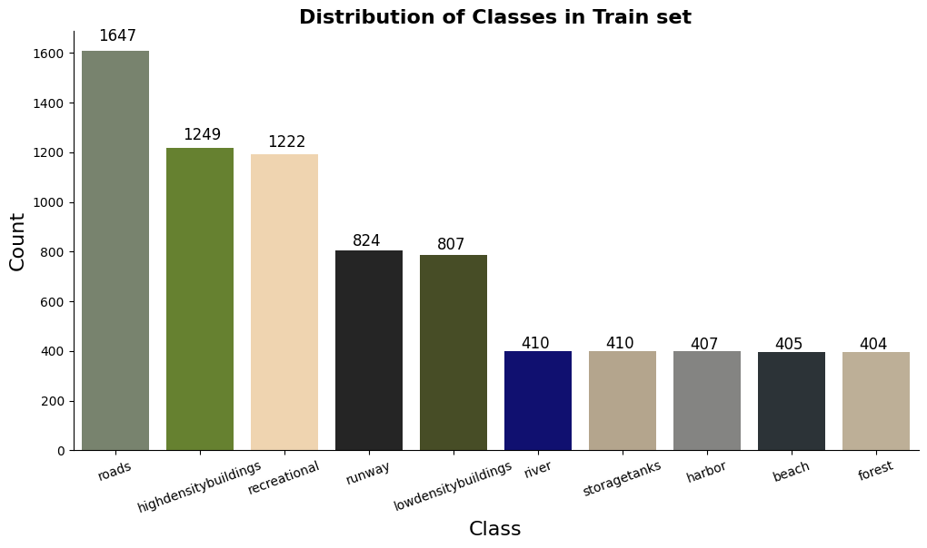
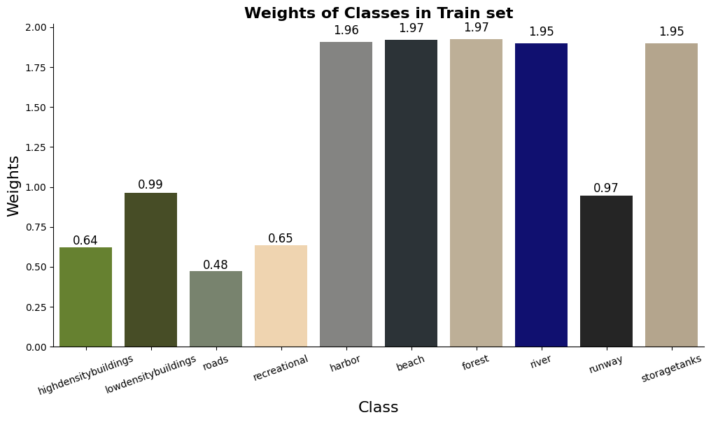
CLASS DISTRIBUTION
Imbalanced distribution
More images of locations with urban infrastructure than natural landscape
Potential issue: Model bias
Preventive measure:
Data Augmentation
Class weights

Slide 15
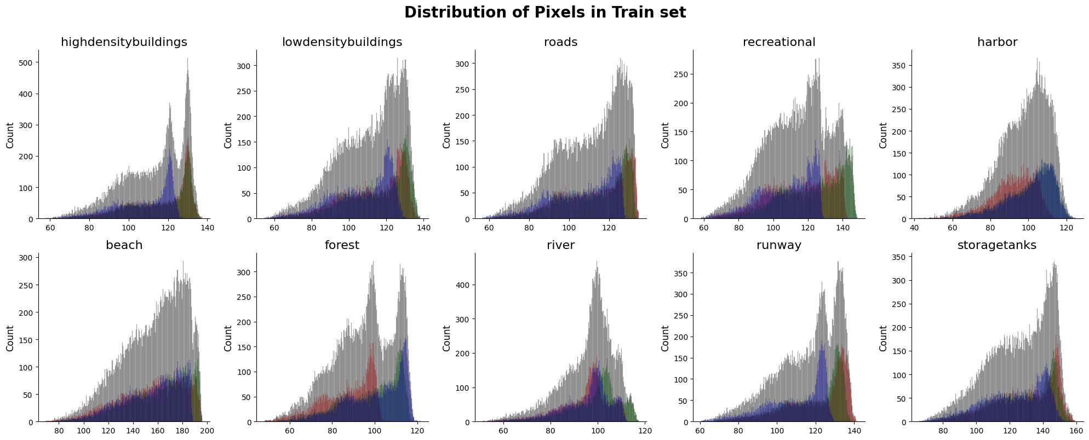
Pixel Distribution
Grayscale Histograms
Brightness: Mostly light in colour
Contrast: Mostly low contrast
RGB Histograms
Left skewed and overlaps among peaks: varied colour palette
Dominant Peaks: oversaturated images

Slide 16
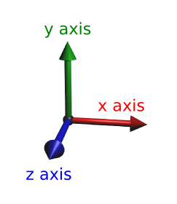
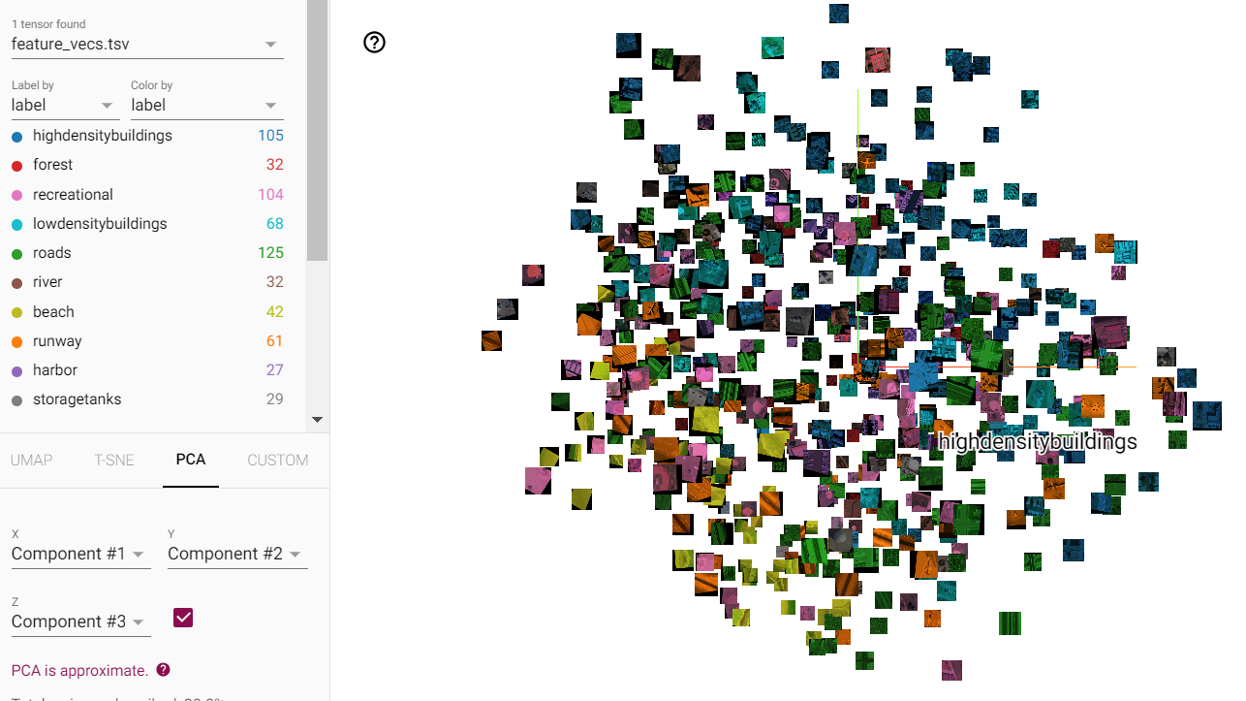
PROJECTION EMBEDDING x & y axes
Clear Clusters
Beach (Yellow) forms a clear cluster
Potential Misclassification
Beach (Yellow) & Recreational (Pink) are closer to each other (on the left)

Slide 17
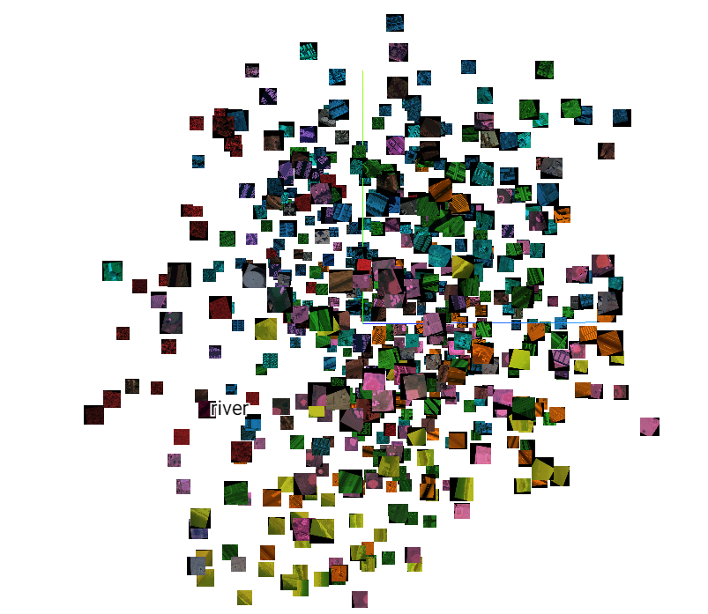
PROJECTION EMBEDDING y & z axes
Clear Clusters
Runway (orange) on the right
Harbor (purple) on top
Potential Misclassification
River (brown) & Forest (red) are close to each other (left)
Potential Low Accuracy
Roads, low density, high density, storage tanks scattered across the plot

Slide 18

MACHINE LEARNING TECHNIQUES
04.
Notes:
Thank you Rachel. When applying machine learning techniques to our use-case, we utilised several sci-kit learn models which act as baseline modes, a Convolutional neural network which we developed, as well as two state of the art models for fine-tuning purposes.

Slide 19
SCIKIT-LEARN MODELS
K-Nearest Neighbours
n_neighbours = 30
Naïve Bayes
Used default GaussianNB()
Decision Tree
max_depth=15
min_samples_split=5
min_samples_leaf=5
class_weight='balanced
random_state=1
Random Forest
n_estimators=150
max_depth=15
min_samples_split=5
min_samples_leaf=10
class_weight='balanced’
random_state=1
Notes:
Mention the type of model (kNN is based on distance, Decision tree is a tree based model, RF is an ensemble model, NB is probabilistic or whatever)
Our baseline classifiers include K-Nearest Neighbours, which is a non-parametric, distance-based model, Gaussian Naïve Bayes, which is a probabilistic model, a Decision tree classifier, and Random forest, which is a tree-based ensemble model. For the sake of time, I won’t explain the underlying operation of the classifiers or their hyperparameters

Slide 20
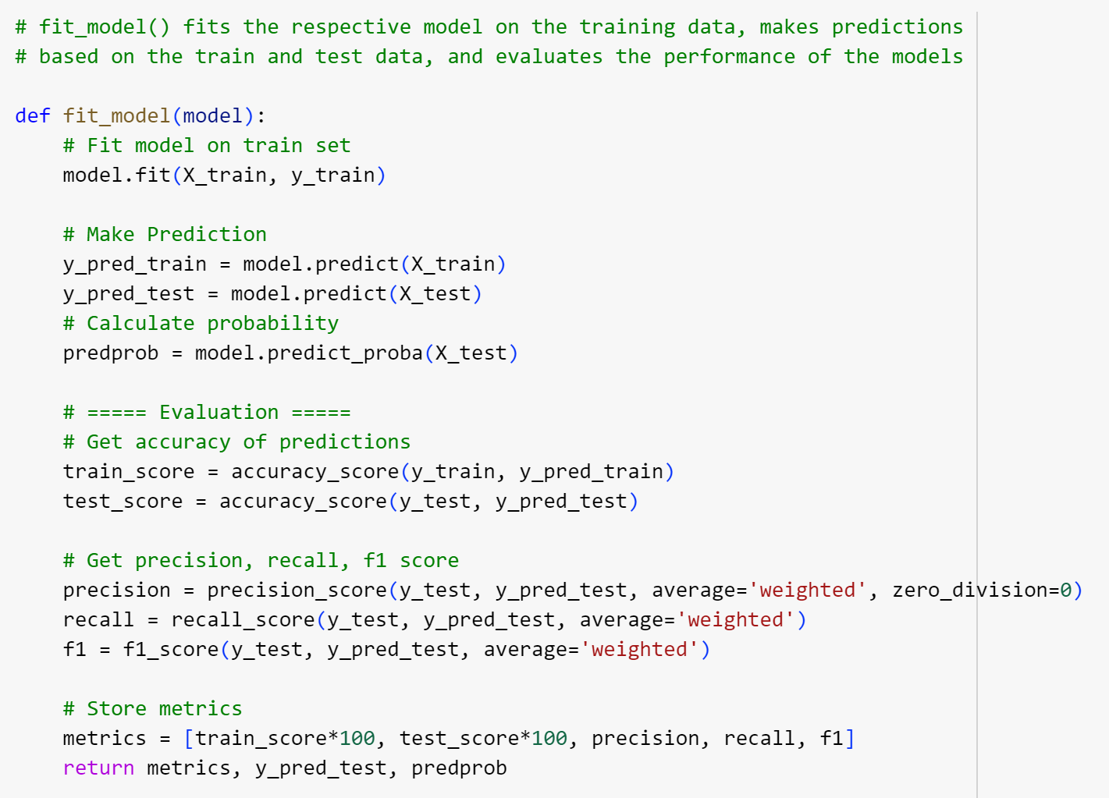
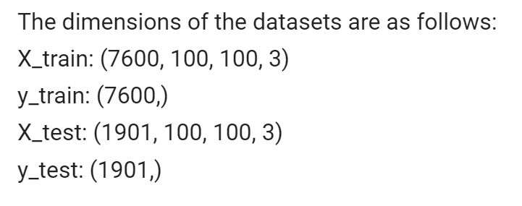
IMPLEMENTATION OF SCIKIT-LEARN MODELS
X_train and x_test datasets were reshaped to (n_samples, n_features)
Data was normalised using MinMaxScaler()
Notes:
For training the baseline models, the dataset was split with a ratio of train to test ratio of 0.8 to 0.2 with stratification using sklearn’s train test split method. The train and test datasets were then reshaped into two dimensional arrays before being normalised using MinMaxScaler. Our machine learning pipeline, from model fitting, to making predictions and evaluating model performance was condensed into a user-defined function, fit_model, as shown on screen.

Slide 21
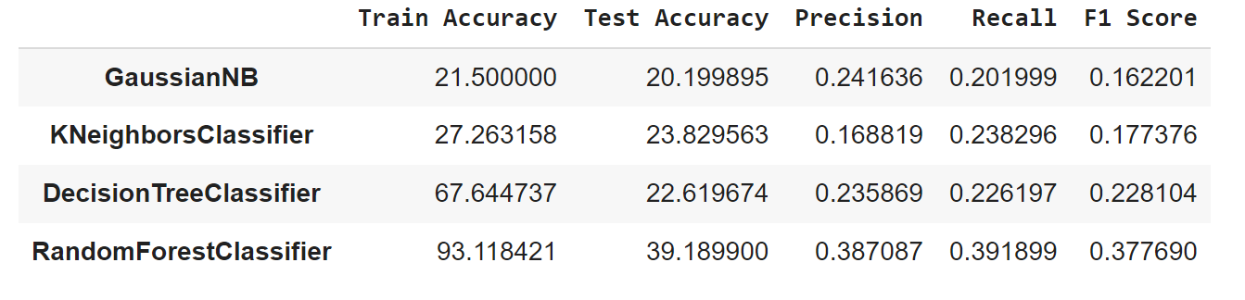
MODEL EVALUATION - METRICS
Accuracy, Precision, Recall, F1:
Large difference indicates severe overfitting
Severely underfitted
Notes:
Out of the 4 models, RF performed the best with a 39% test accuracy and 0.37 F1 score, however, the vast difference between its train and test accuracy is an indication of severe overfitting. On the other hand, the poor train and test accuracies of naive bayes and knn are indicative of severe underfitting, meaning that the models are unable to discern the underlying patterns in the data.

Slide 22
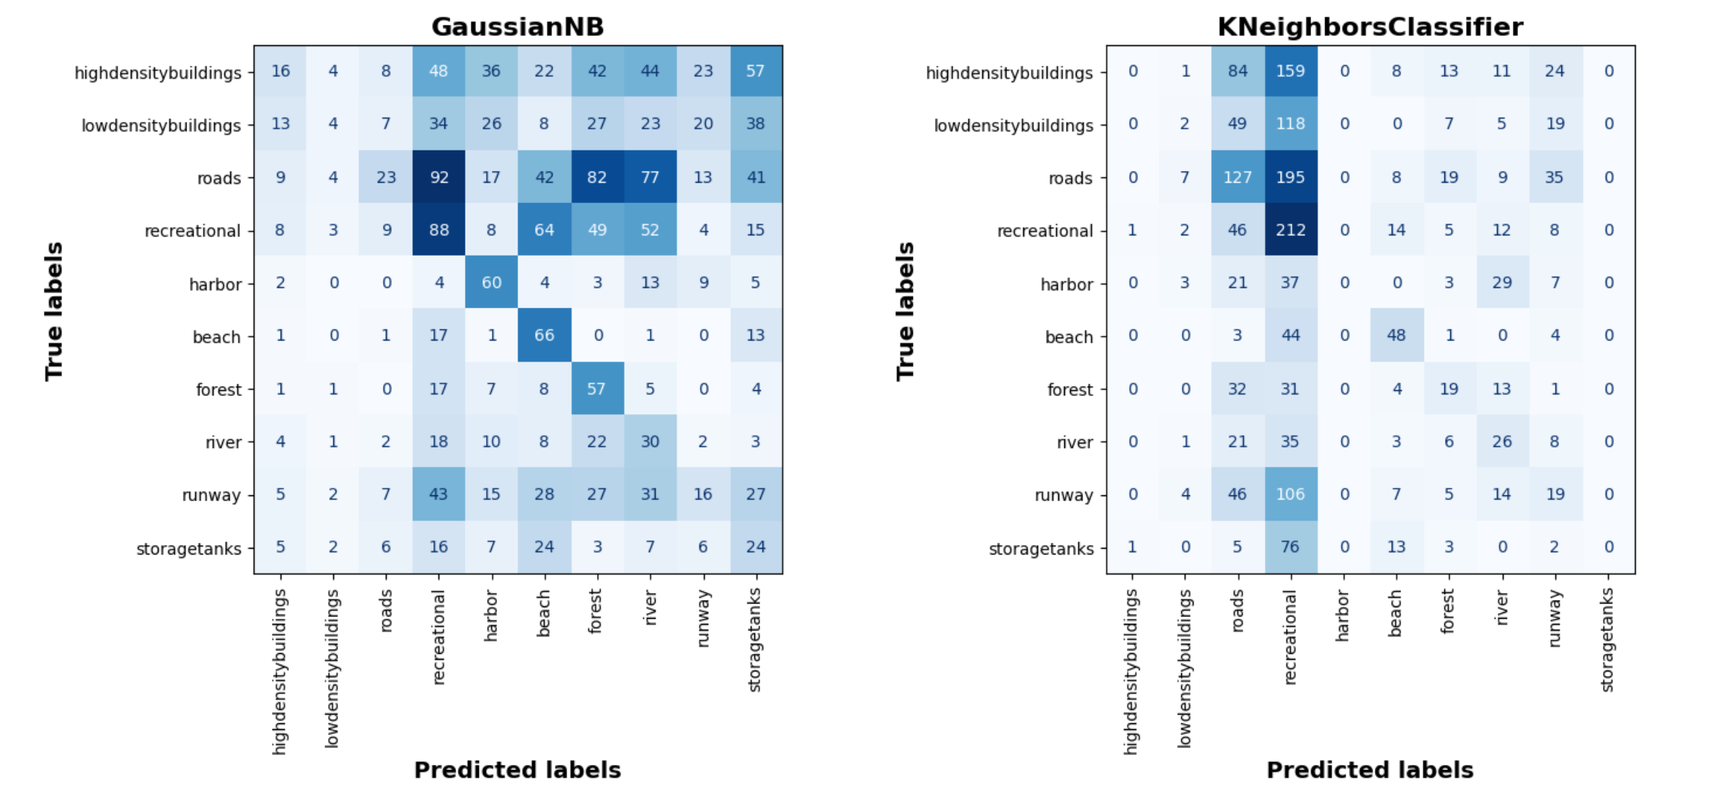
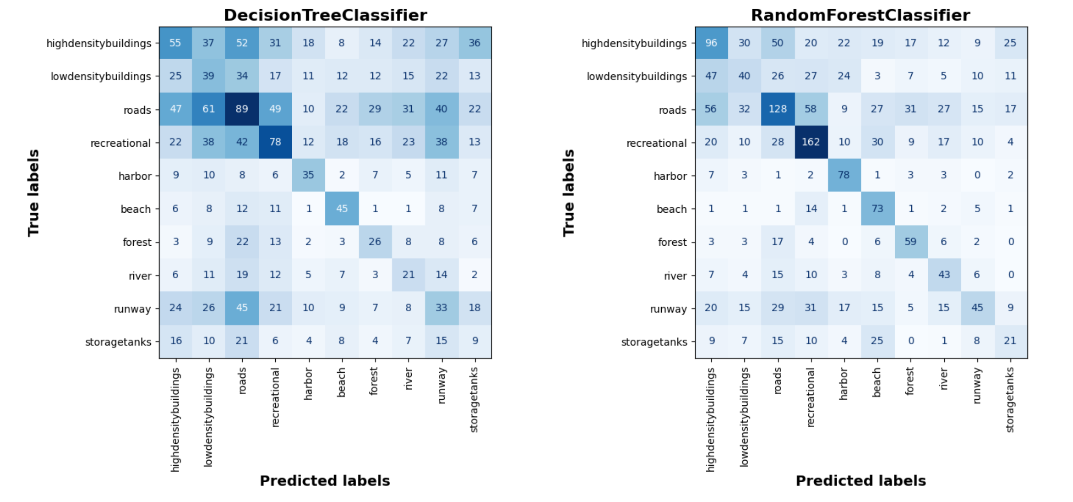


MODEL EVALUATION – CONFUSION MATRIX
Notes:
In the naïve bayes confusion matrix, a slight diagonal pattern is observable, showing that the classifier was able to predict some classes correctly, especially in the recreational, harbour, beach, and forest classes. However, it was barely able to accurately predict the two building classes, with 16 and 4 correct classifications for high and low density buildings respectively. Many misclassifications occurred in first and last three classes. The KNN confusion matrix was able to predict roads and recreational relatively well, with 127 and 212 correct predictions respectively. The next best predicted class is beach with 48 correct predictions. Nevertheless, it still struggled with all the other classes.

Slide 23
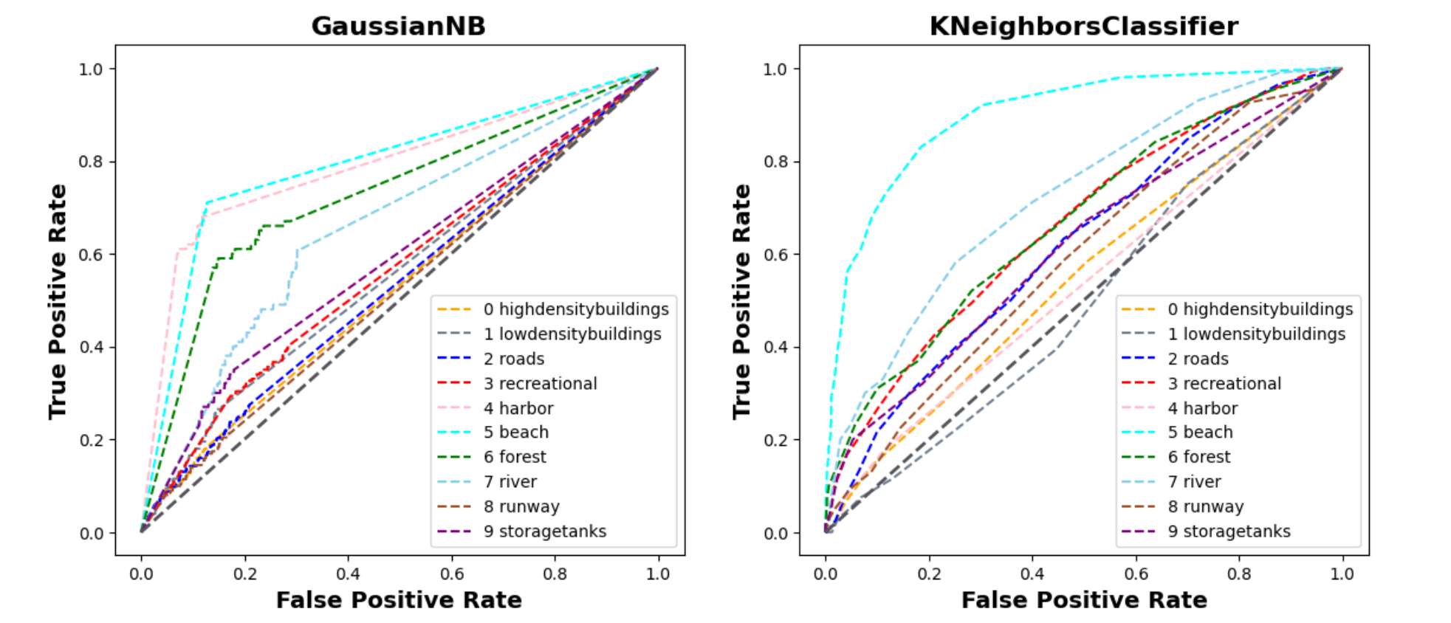
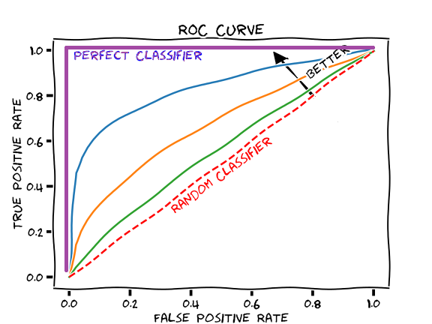
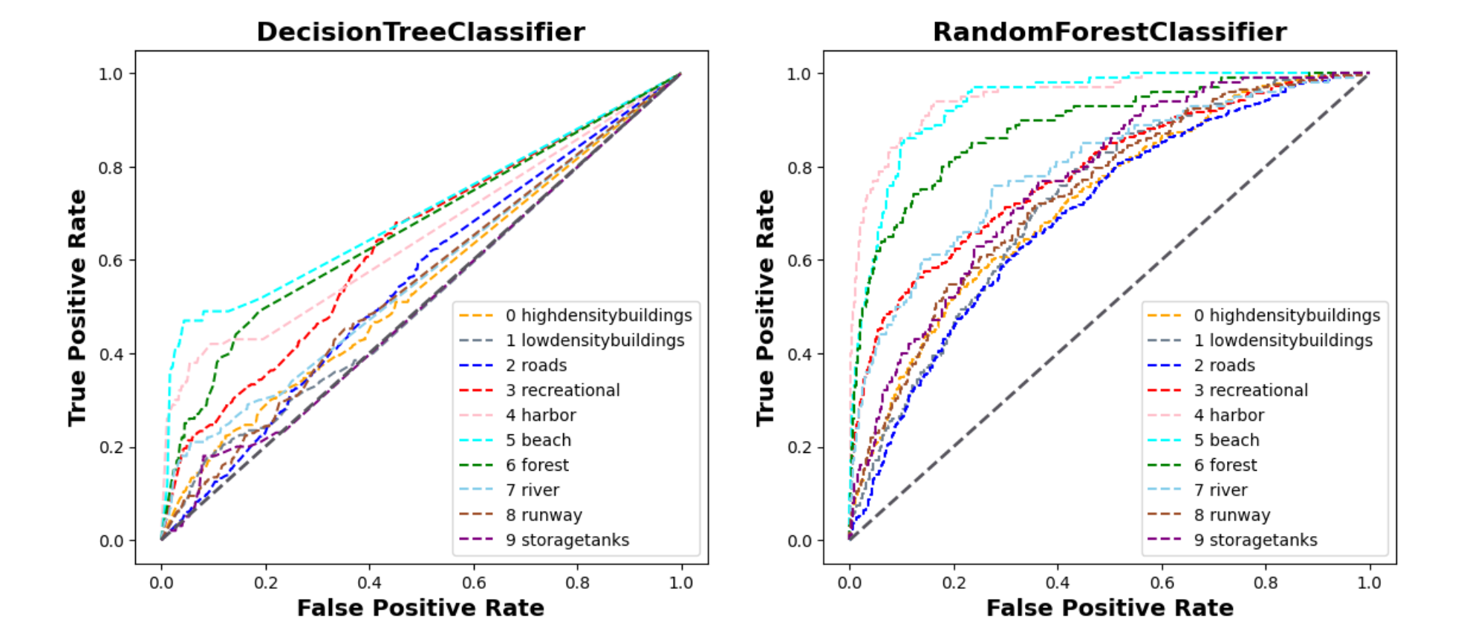
MODEL EVALUATION – AUC ROC CURVE
Notes:
In the plots above, the straight diagonal line (dark grey) indicates an AUC score of 0.5 meaning that the classifier is not able to distinguish between Positive and Negative class points (i.e., the classifier either predicts a random class or a constant class for all the data points). The KNN classifier seems to have performed better on the beach class compared to other classes, but has performed very poorly on the low-density buildings class, as shown by the AUC-ROC curve being below the baseline. It also performed poorly for the harbour and high-density buildings classes as they are close to baseline performance. The GaussianNB has performed somewhat decently on the beach, harbour, river, and forest classes compared to the remaining classes, which are very close to baseline performance. The decision tree classifier has performed poorly across most classes while the random forest classifier performs reasonably well across most classes, especially the beach, harbour, and forest classes.

Slide 24
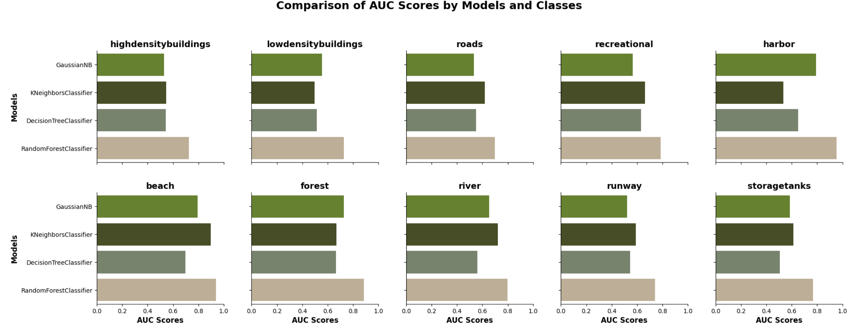
MODEL EVALUATION – AUC ROC SCORE BY CLASS

Slide 25
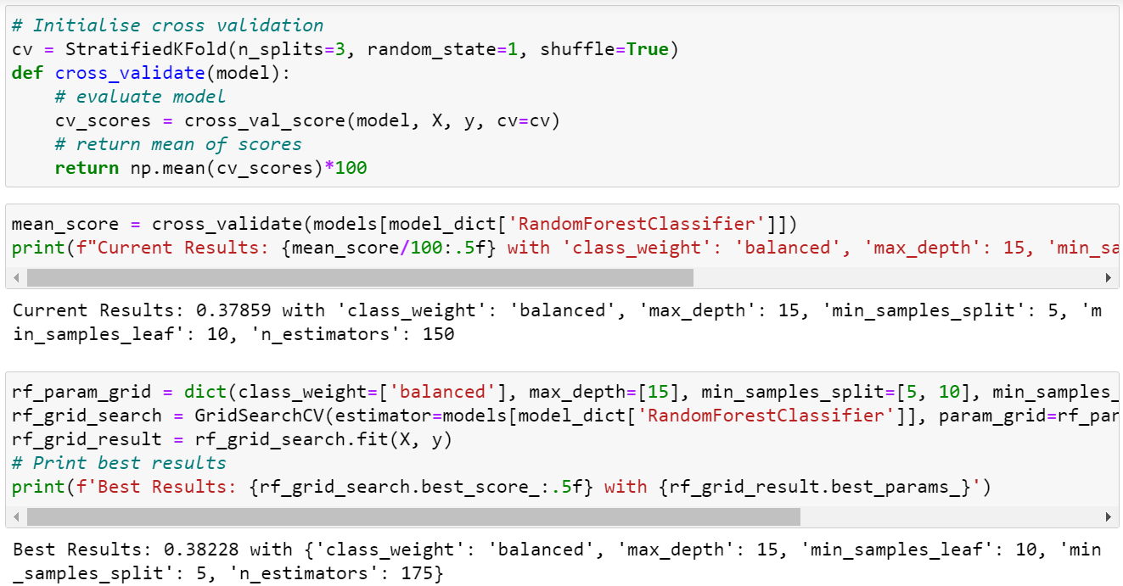
Model Improvement
Approach
Hyperparameter Tuning with stratified K fold cross validation
Modified Random Forest model’s parameters to reduce overfitting
Evaluation
Cross validation accuracy improved slightly
Overfitting still persists
Notes:
In an attempt to improve and reduce overfitting in the RF model, which had the best performance out of the four, we conducted hyper-parameter tuning with stratified K-fold cross validation. Unfortunately, there was only a marginal improvement in the accuracy score from 0.378 to 0.382 and overfitting was still an issue. Overall, it was unsurprising that the scikit learn models performed poorly on this image classification task as image classification tends to be very complex. I will now pass the time to Sanjana to describe our CNN model

Slide 26
CNN MODEL
Resizing Layer
Resizes images’ dimensions from 256x256 to 100x100
Convolutional Layers
Applies ReLU transformation to feature map
Max Pooling Layers
Selects the pixel with maximum value to send to the output array
Fully-connected Layers
Classifies images based on features extracted through previous layers
(IBM, n.d.)

Slide 27
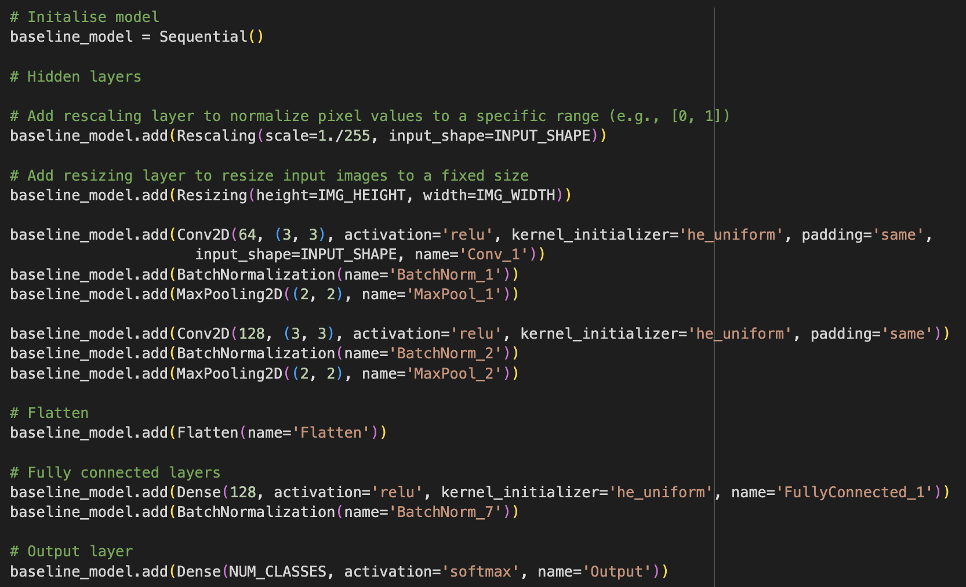
BASELINE MODEL BUILDING

Slide 28
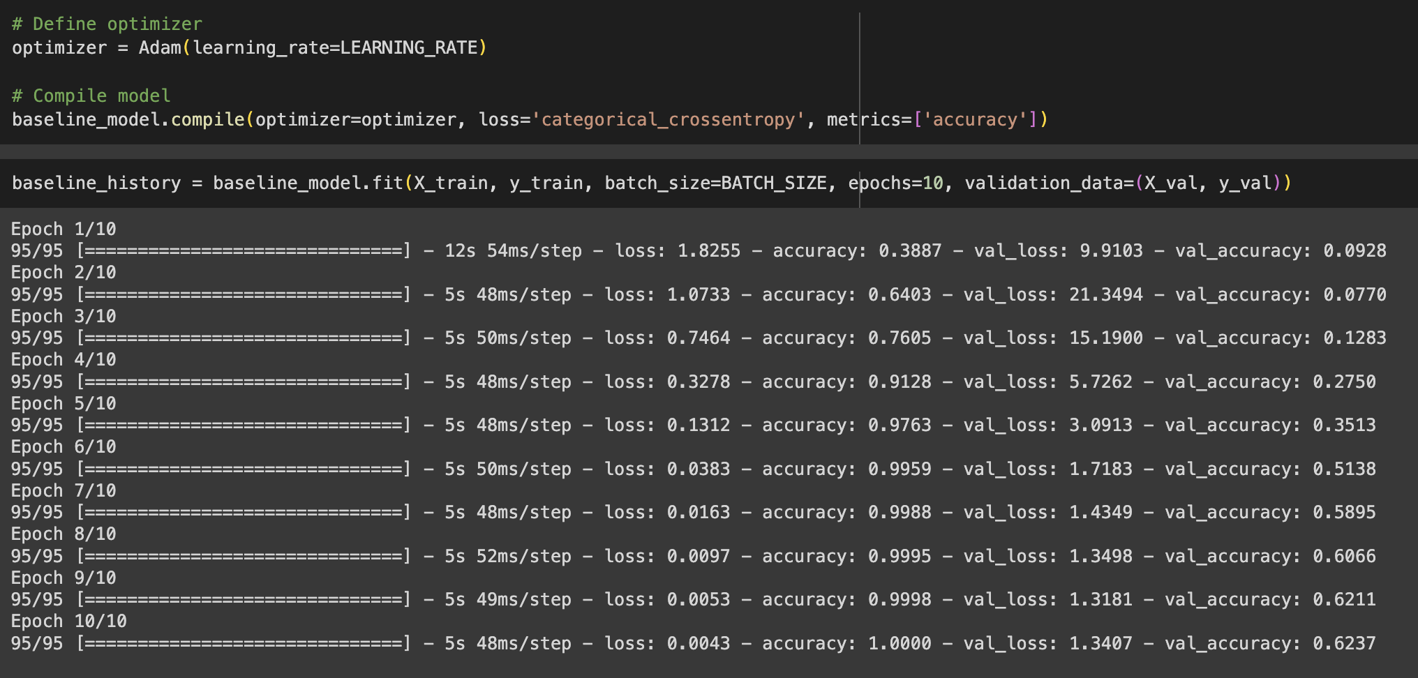
BASELINE MODEL EVALUATION

Slide 29
AIMS FOR IMPROVED MODEL
Reduce overfitting and improve efficiency
Implement dropout regularisation
Add more max pooling layers
Carry out data augmentation
Improve accuracy
Increase number of epochs
Add more convolutional layers
Implement more batch normalisation

Slide 30
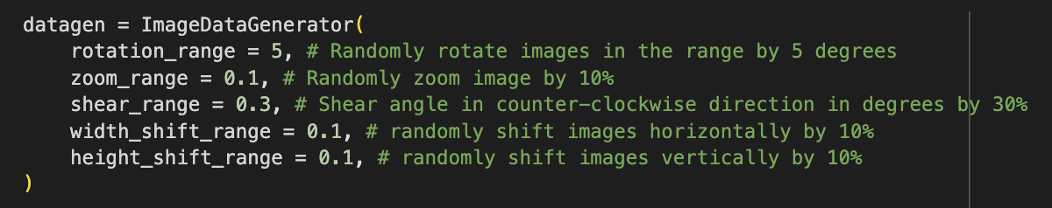
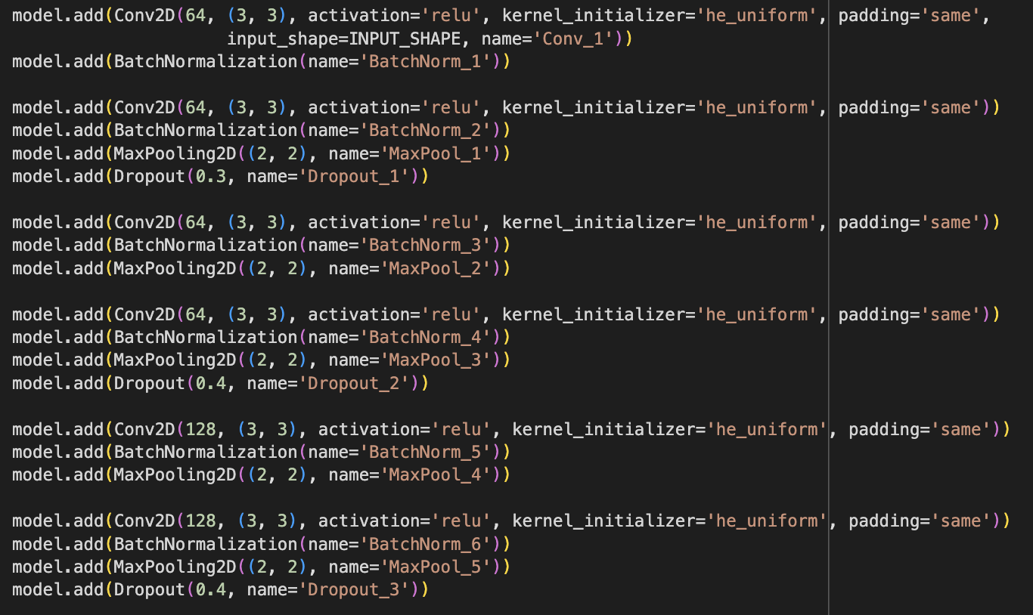
IMPROVED MODEL BUILDING

Slide 31
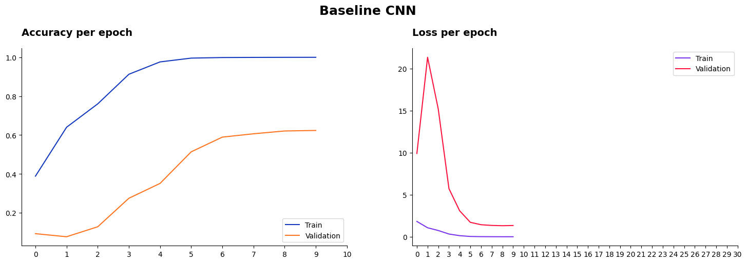
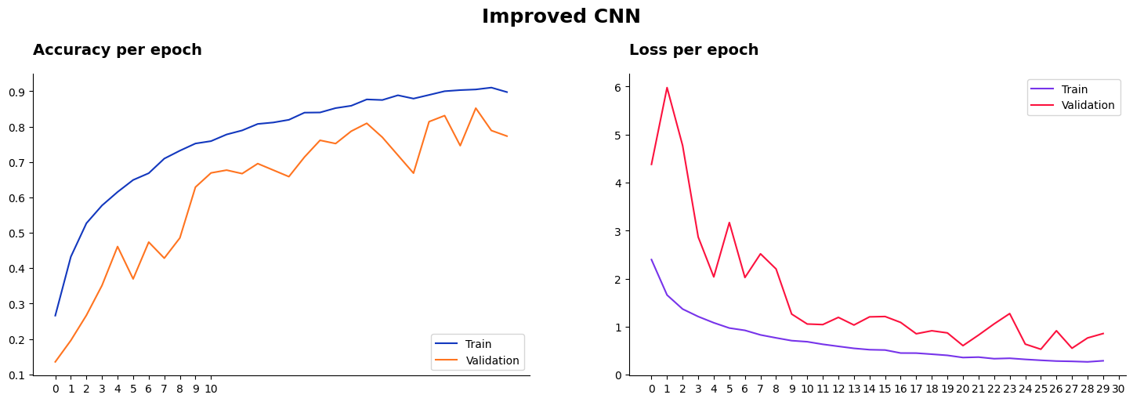
MODEL COMPARISON – ACCURACY/LOSS PER EPOCH

Slide 32
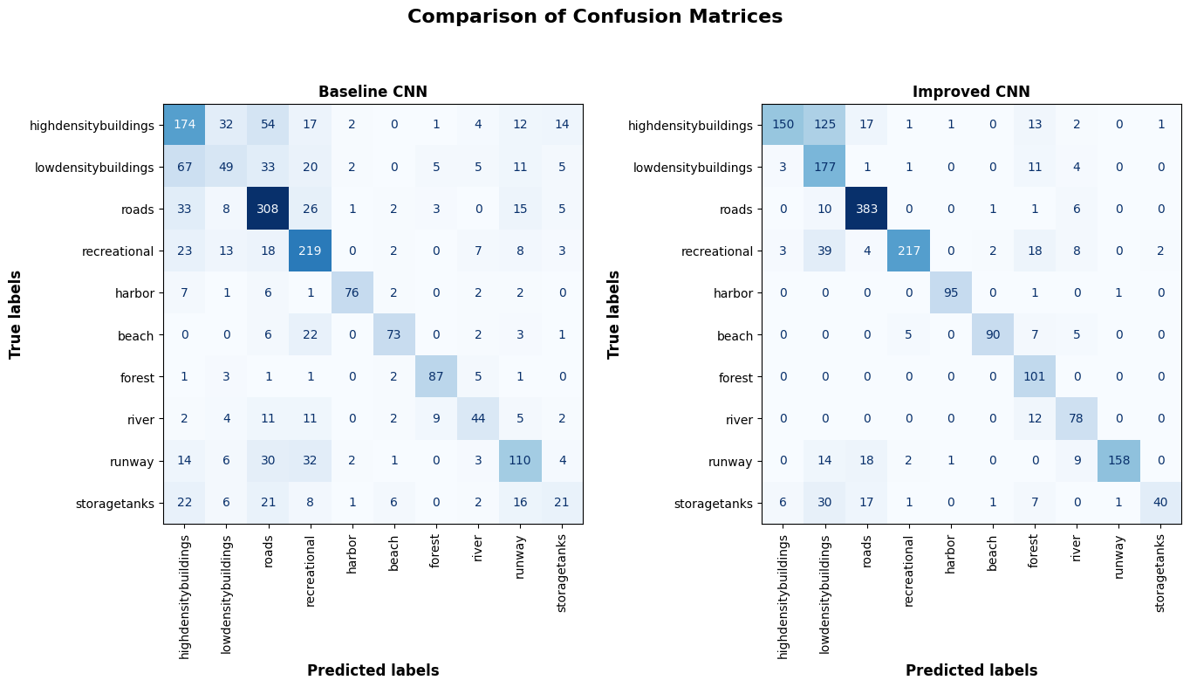
MODEL COMPARISON – CONFUSION MATRICES

Slide 33
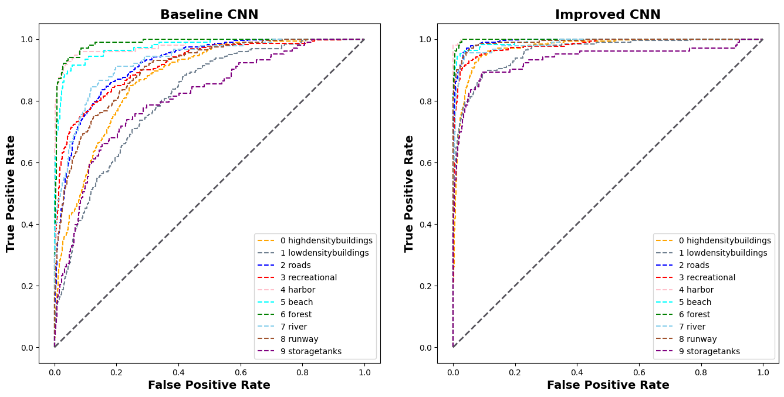
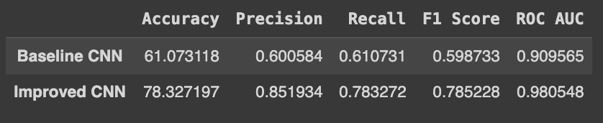
MODEL COMPARISON – AUC/ROC

Slide 34
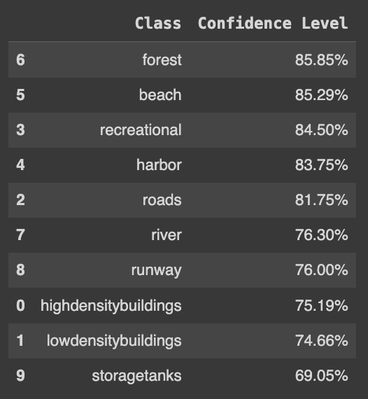
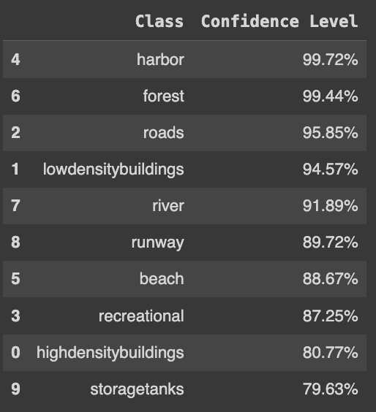
MODEL COMPARISON – CONFIDENCE
Baseline Model
Improved Model

Slide 35
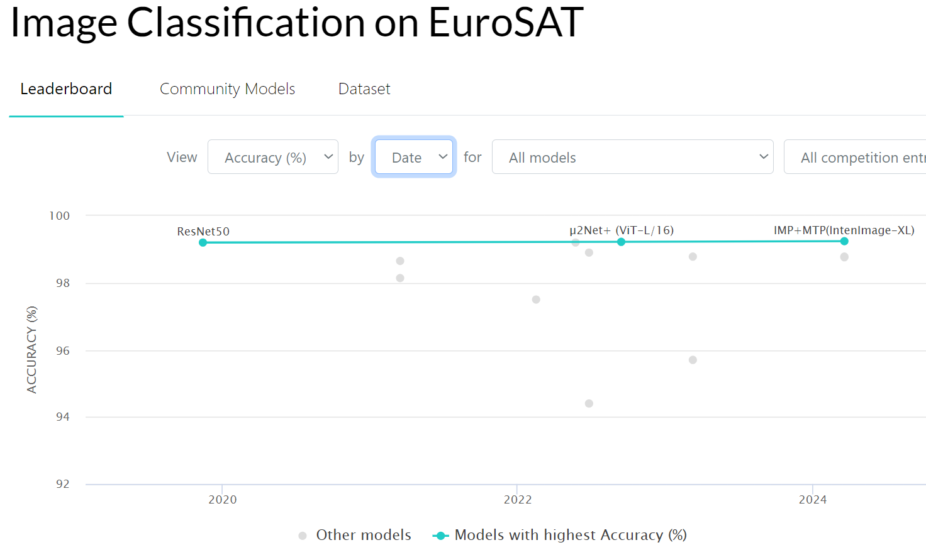
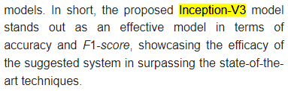
Finetuning with SOTA Models
EuroSAT: benchmark for land use classification
ResNet50 ranks high (4th) on EuroSAT
(Fayaz et al., 2024) claimed that Inception-V3 outperformed ResNet50 on the UCMerced Landuse dataset

Slide 36
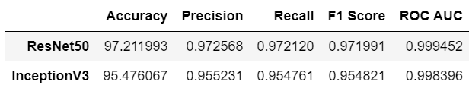
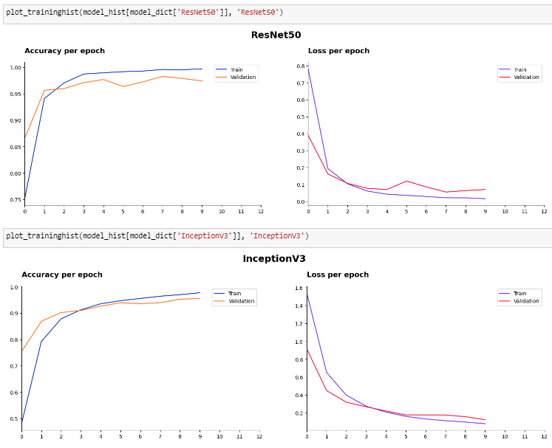
Model Evaluation
Both models performed well for all metrics
Highly accurate and capable of distinguishing between the classes
No overfitting
ResNet50 performed slightly better in all metrics

Slide 37




Insights
Storage Tanks
Rivers
Low-density Buildings
High-density Buildings
LOWEST CONFIDENCE
Notes:
Models are least confident in these 4 classes: low-density buildings, high density buildings, river, and storage tanks
For river and storage tanks, it is likely a result of the lack of images and that these classes can easily be confused for other classes (rivers can be mistaken for harbours, runways, and forests) (storage tanks can be mistaken as low density buildings or harbours)
For buildings, it is likely that the model gets confused between the two classes

Slide 38





Recommendations & Enhancements
RECOMMENDATIONS
ENHANCEMENTS
Collect more data
Situation-specific alerts
Use the ResNet50 model for the most accurate results
Detect people & vehicles
Weather augmentation
Notes:
Collect more data for the 4 classes that have a lower accuracy
Further segregate the classes and configure the drone to produce different alerts based on the importance of the location
Incorporate detection of people/vehicles
Weather augmentation to ensure accuracy even in varying weather conditions

Slide 39
Our Takeaways
How to create a projection embedding for images
How to use sklearn models, CNN models, and finetune SOTA models on an image classification task
How to troubleshoot a model that is overfitted
For complex and poor-quality image data, it would be best to use a neural network to train instead of sklearn models

Slide 40
Thank You!

Slide 41
References
Guilmartin, J., & Taylor, J. (2024, April 18). Unmanned aerial vehicles (UAVs). Retrieved from Encylopaedia Brittanica : https://www.britannica.com/technology/unmanned-aerial-vehicle
Fayaz, M., Nam, J., Dang, L. M., Song, H.-K., & Moon, H. (2024). Land-cover classification using deep learning with high-resolution remote-sensing imagery. Applied Sciences, 14(5), 1844. https://doi.org/10.3390/app14051844
HHLH Sky GmbH. (2023, December 6). Strategic Benefits of Using Automated Drones for Enterprise Operations. (HHLH Sky GmbH) Retrieved from https://www.linkedin.com/pulse/strategic-benefits-using-automated-drones-enterprise-operations-zlhse/
Mohsan, S. A., Othman, N. Q., Yanglong, L., Alsharif, M. H., & Muhammad, A. K. (2023). Unmanned aerial vehicles (UAVs): practical aspects, applications, open challenges, security issues, and future trends. Intell Serv Robot, 16(1), 109–137.
IBM. (n.d.). What are convolutional neural networks? Retrieved from IBM: https://www.ibm.com/topics/convolutional-neural-networks
Ng, W. K. (2022, September 28). Singapore Army and RSAF link drones for the first time to give soldiers more intel. Retrieved from The Straits Times: https://www.straitstimes.com/singapore/army-and-airforce-link-drones-for-the-first-time-to-give-soldiers-more-intel
Papers with Code. (n.d.). Papers with code—Eurosat benchmark (Image classification). Retrieved from Papers with Code: https://paperswithcode.com/sota/image-classification-on-eurosat

